Slide 1
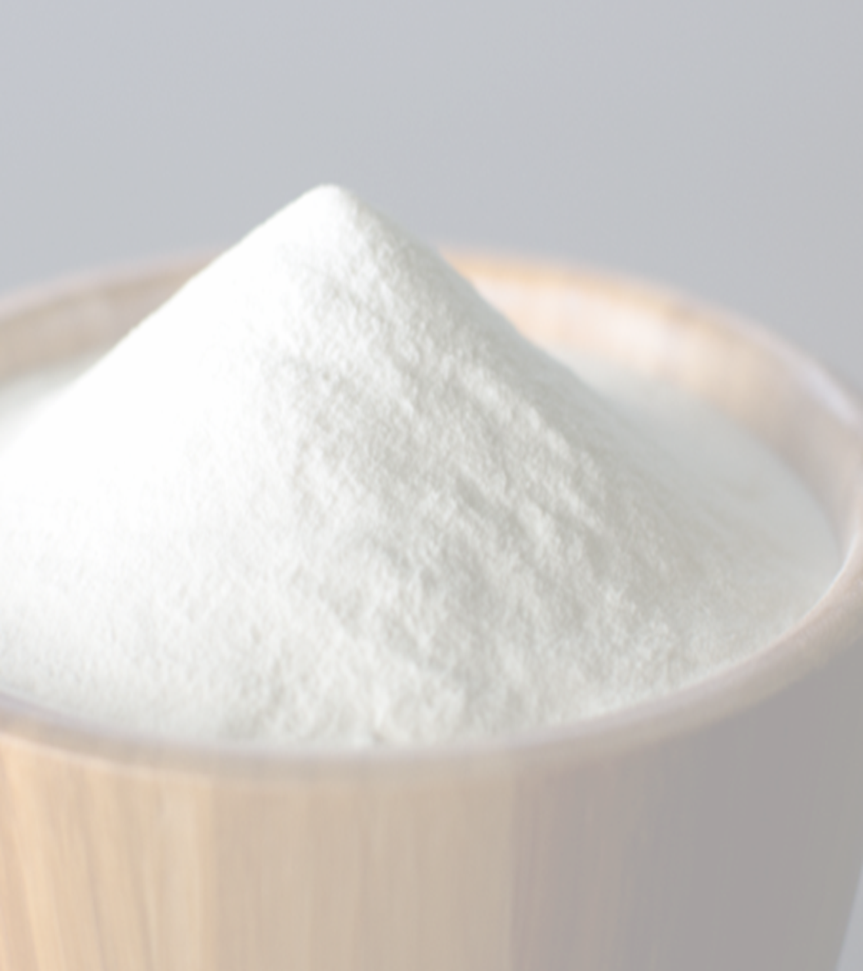
Main Attributes of Agave Inulin
Agave Inulin main attribute is "insolubility" consisting of the ability to pass through all digestive tract, surviving the acidity (PH) of the stomach and reaching large intestine to fulfill its main function: feed the ¨good¨ bacteria (bifid bacteria) in charge of unfolding the foods and realizing the use of all nutrients.
In addition, some other attributes are:
It is an aid in the treatment of colitis and gastritis.
Stimulates the growth of intestinal flora.
It is useful for combating constipation.
In case of ailments caused by cholesterol and high triglycerides, agave inulin helps to lower them.
Inhibit the growth of pathogenic bacteria (E.Coli, Listeria, Shigella, Salmonella).
Agave Inulin is tolerated by people with diabetes and is ideal for hypoglycemic, since both cases regulate insulin levels.
Increases bioavailability of minerals through the intestine.
Inulin can be used as a fiber in any food without changing its desired characteristics because it does not add flavor or color.

